Slide 1
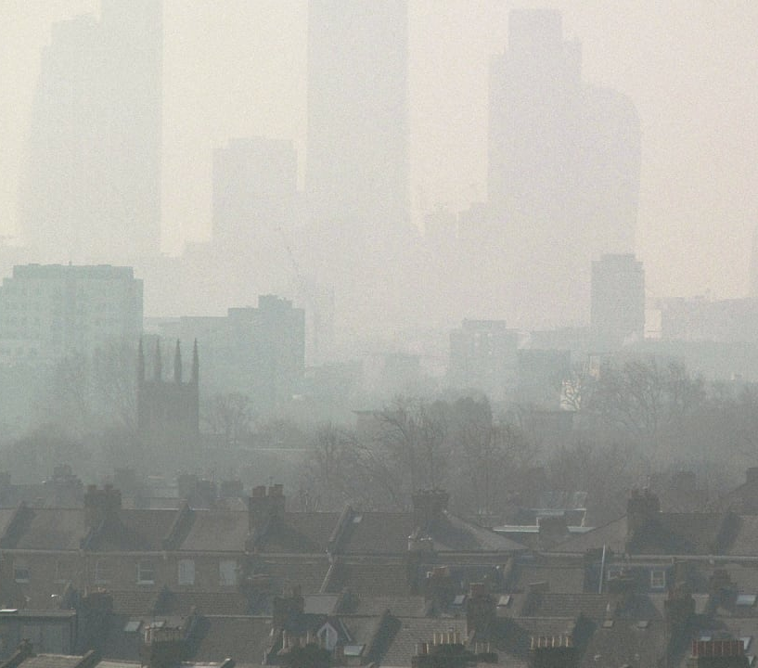
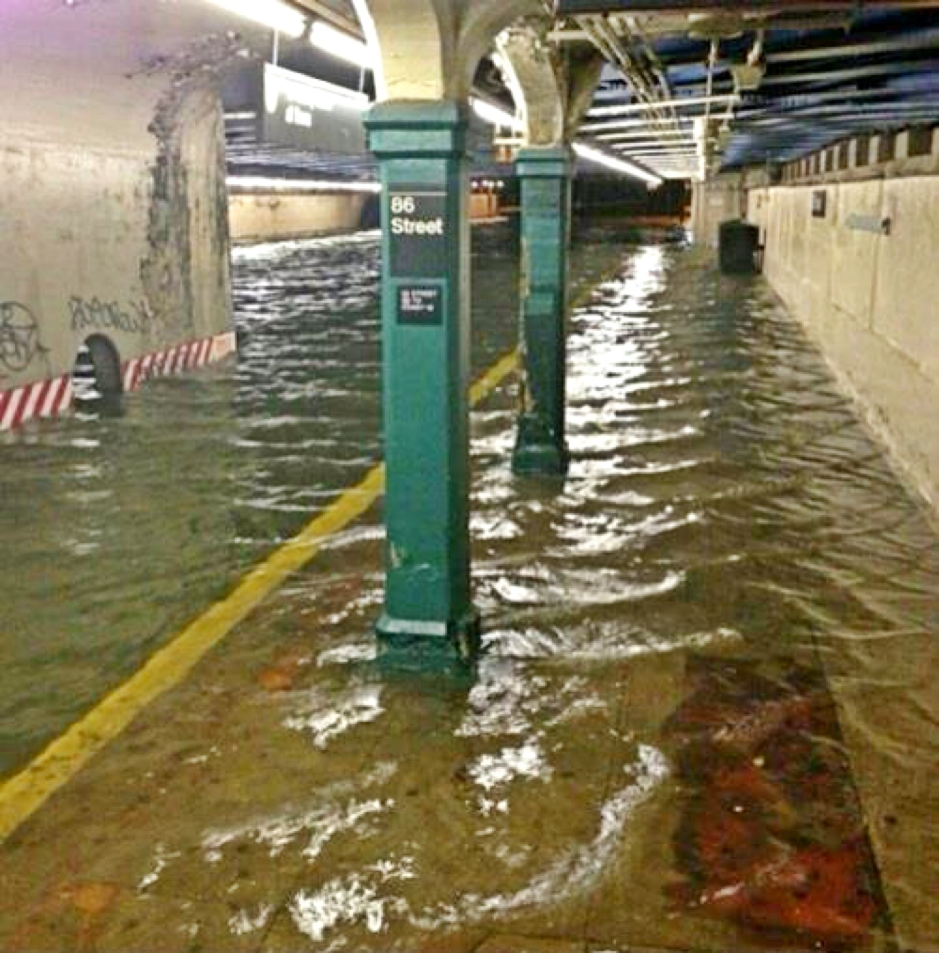
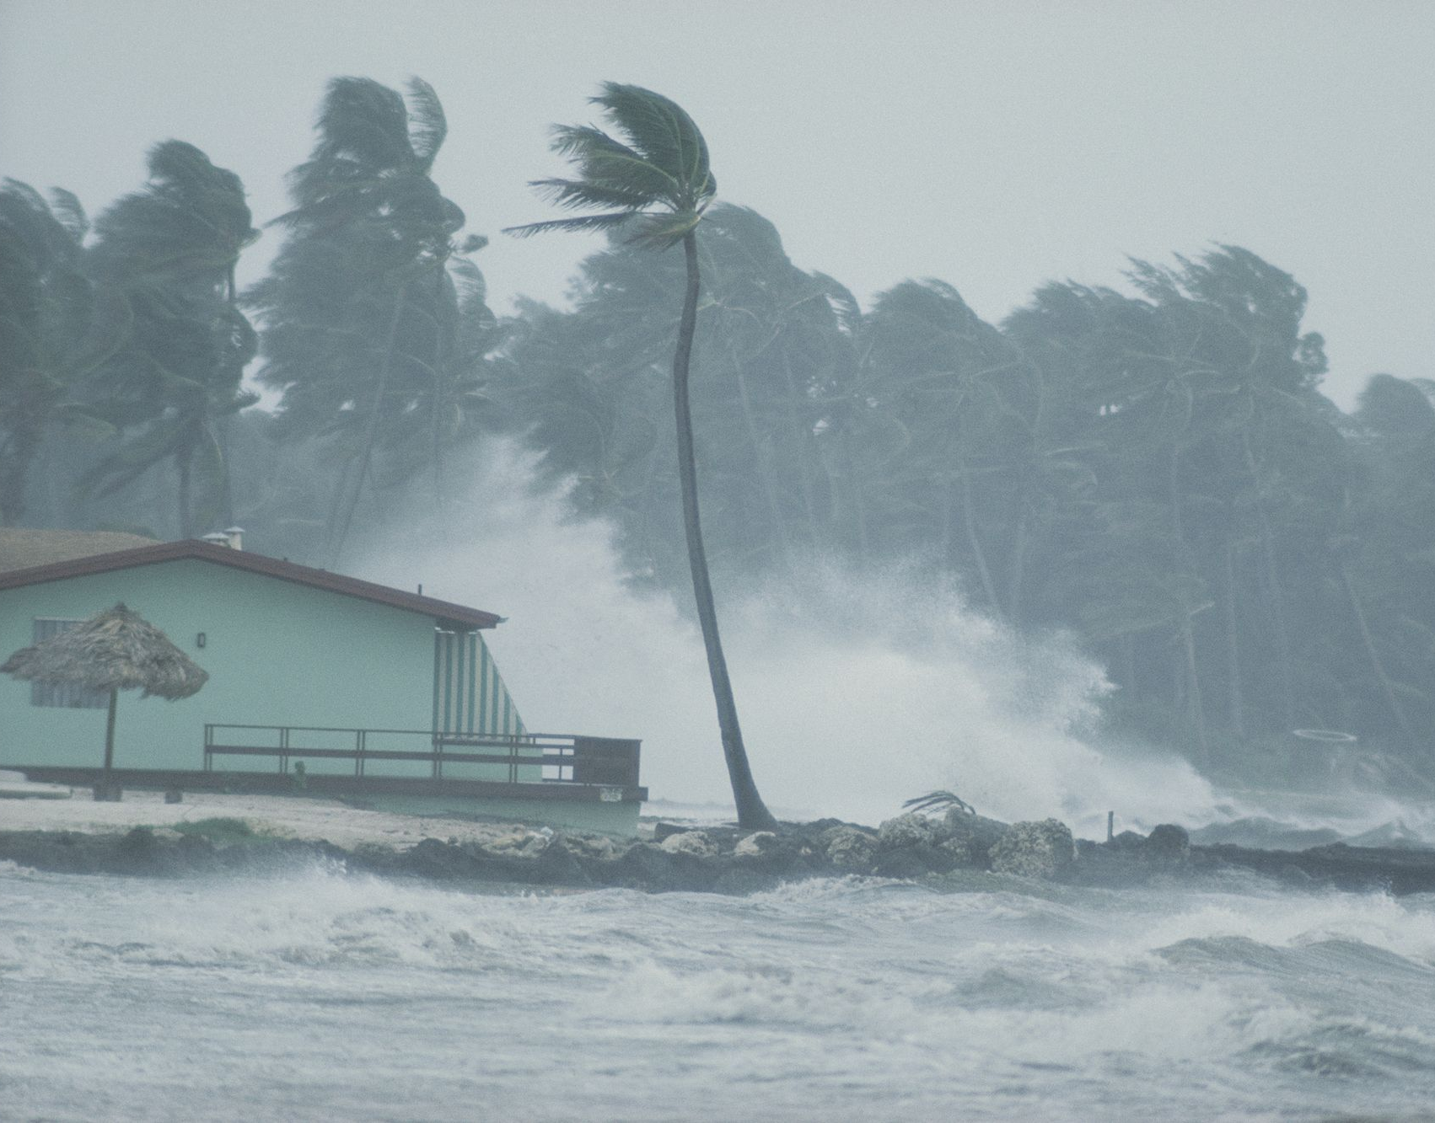
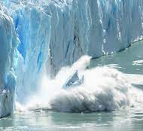
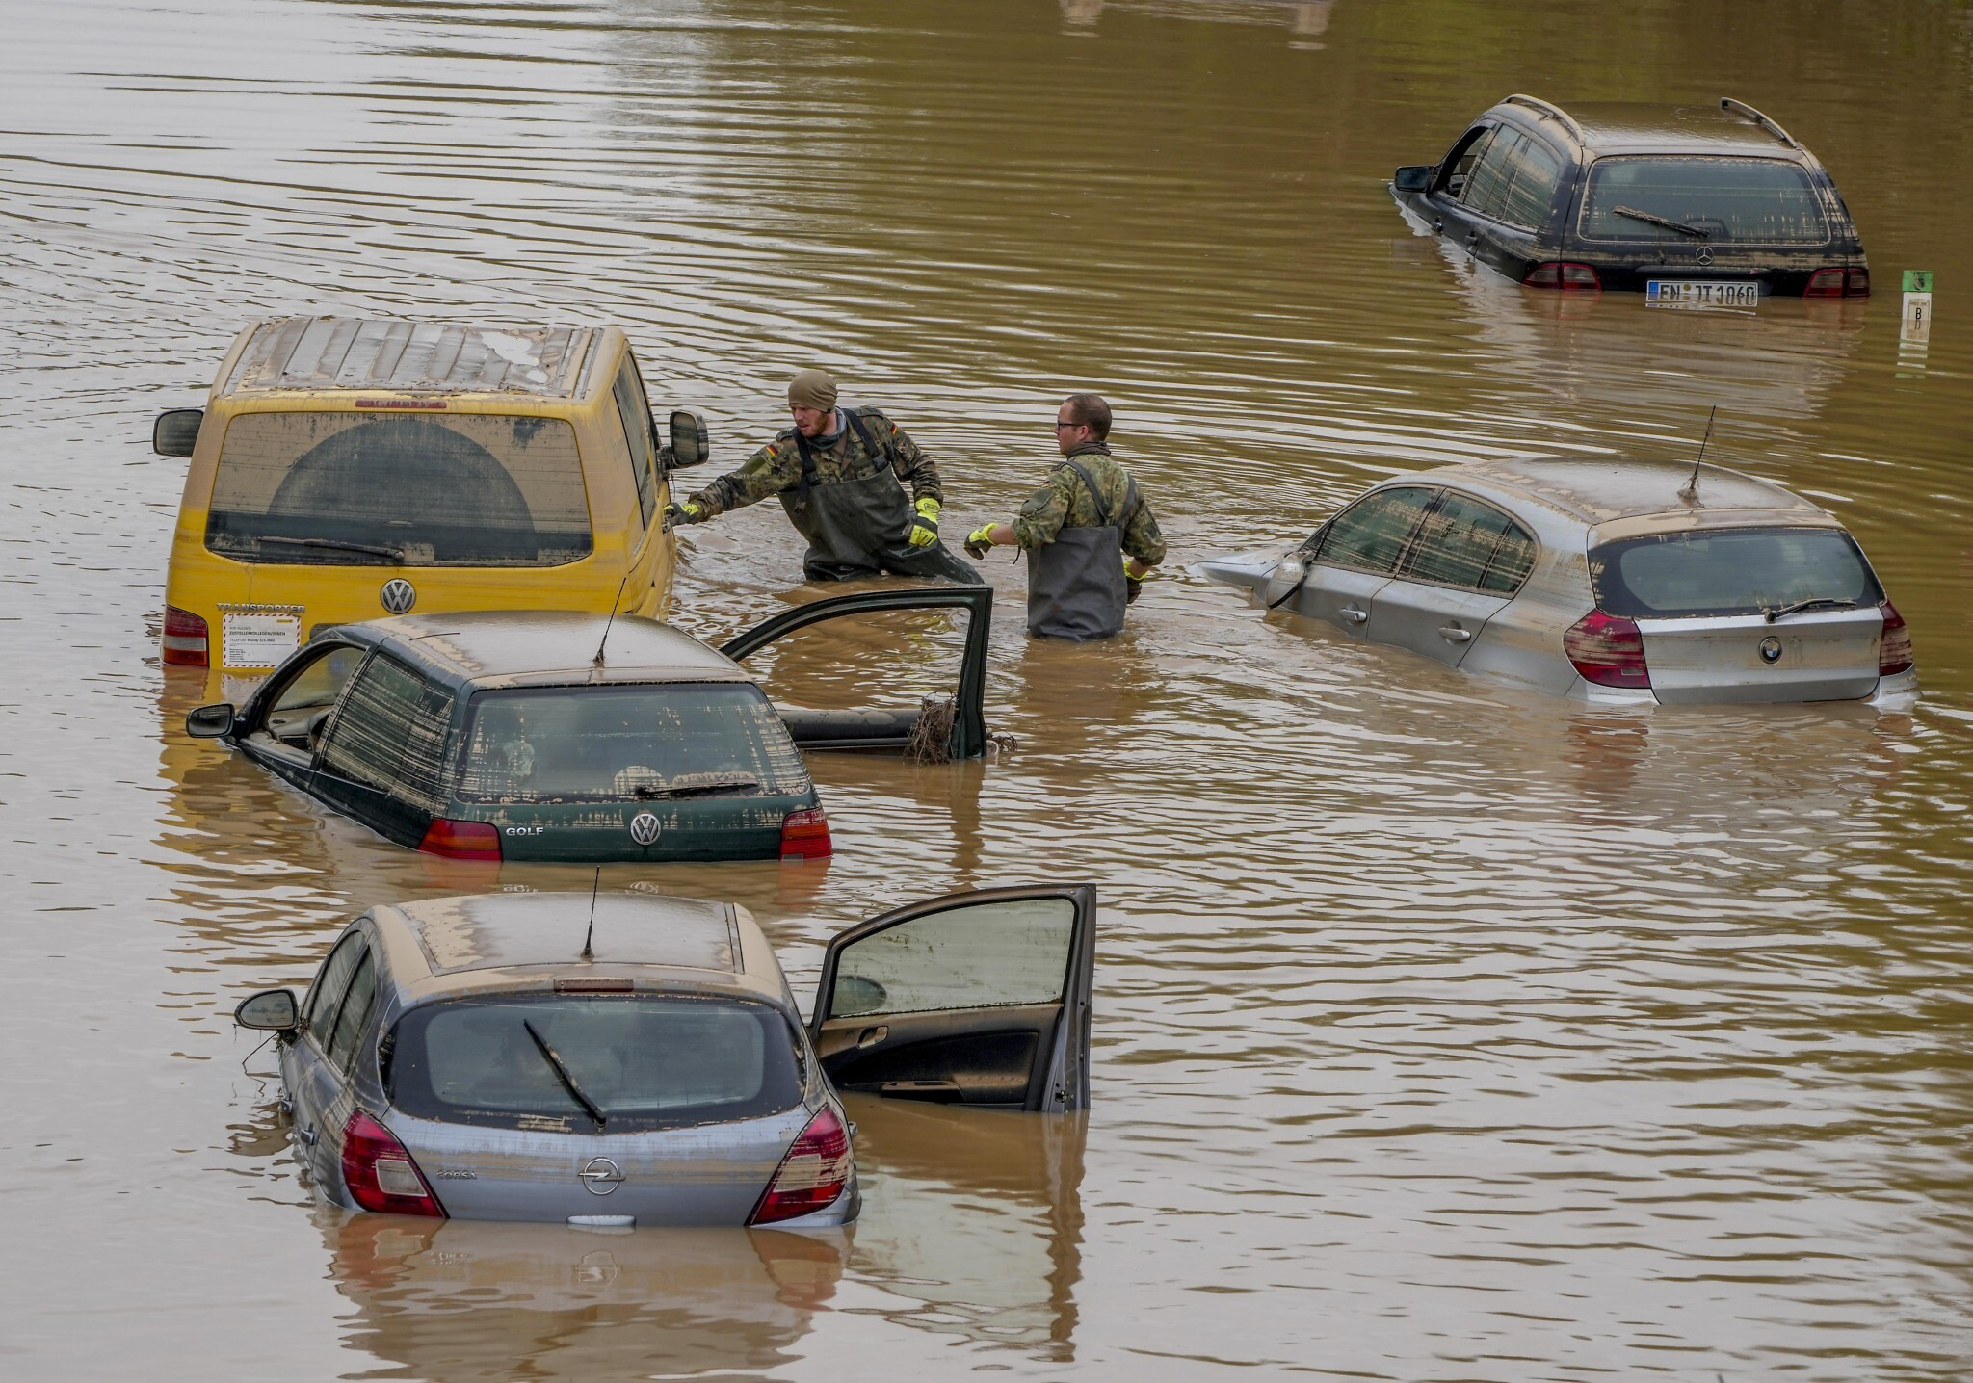
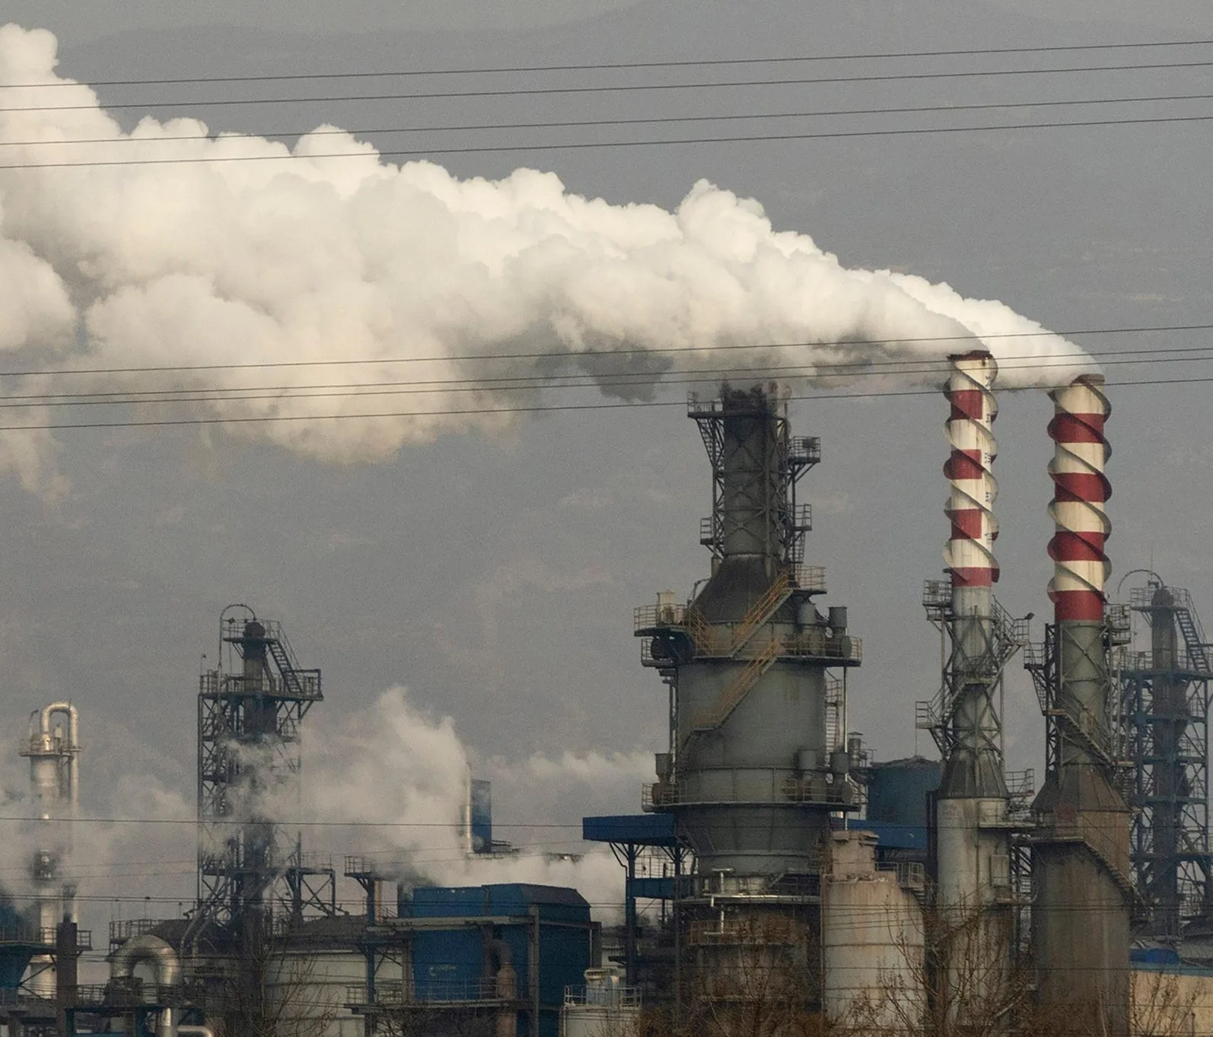
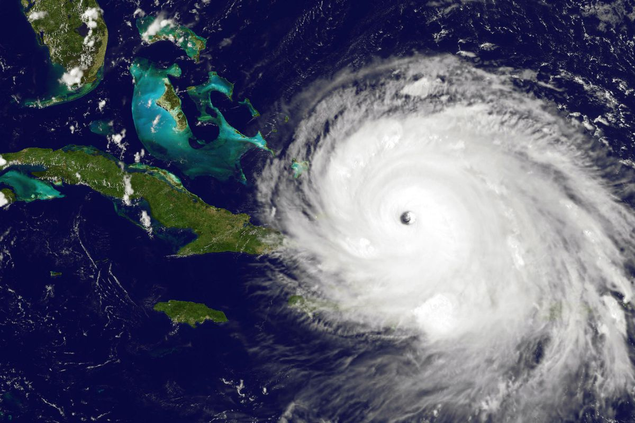
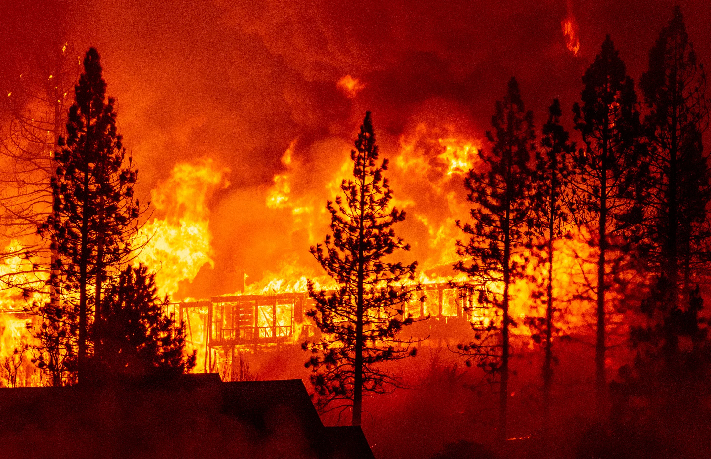
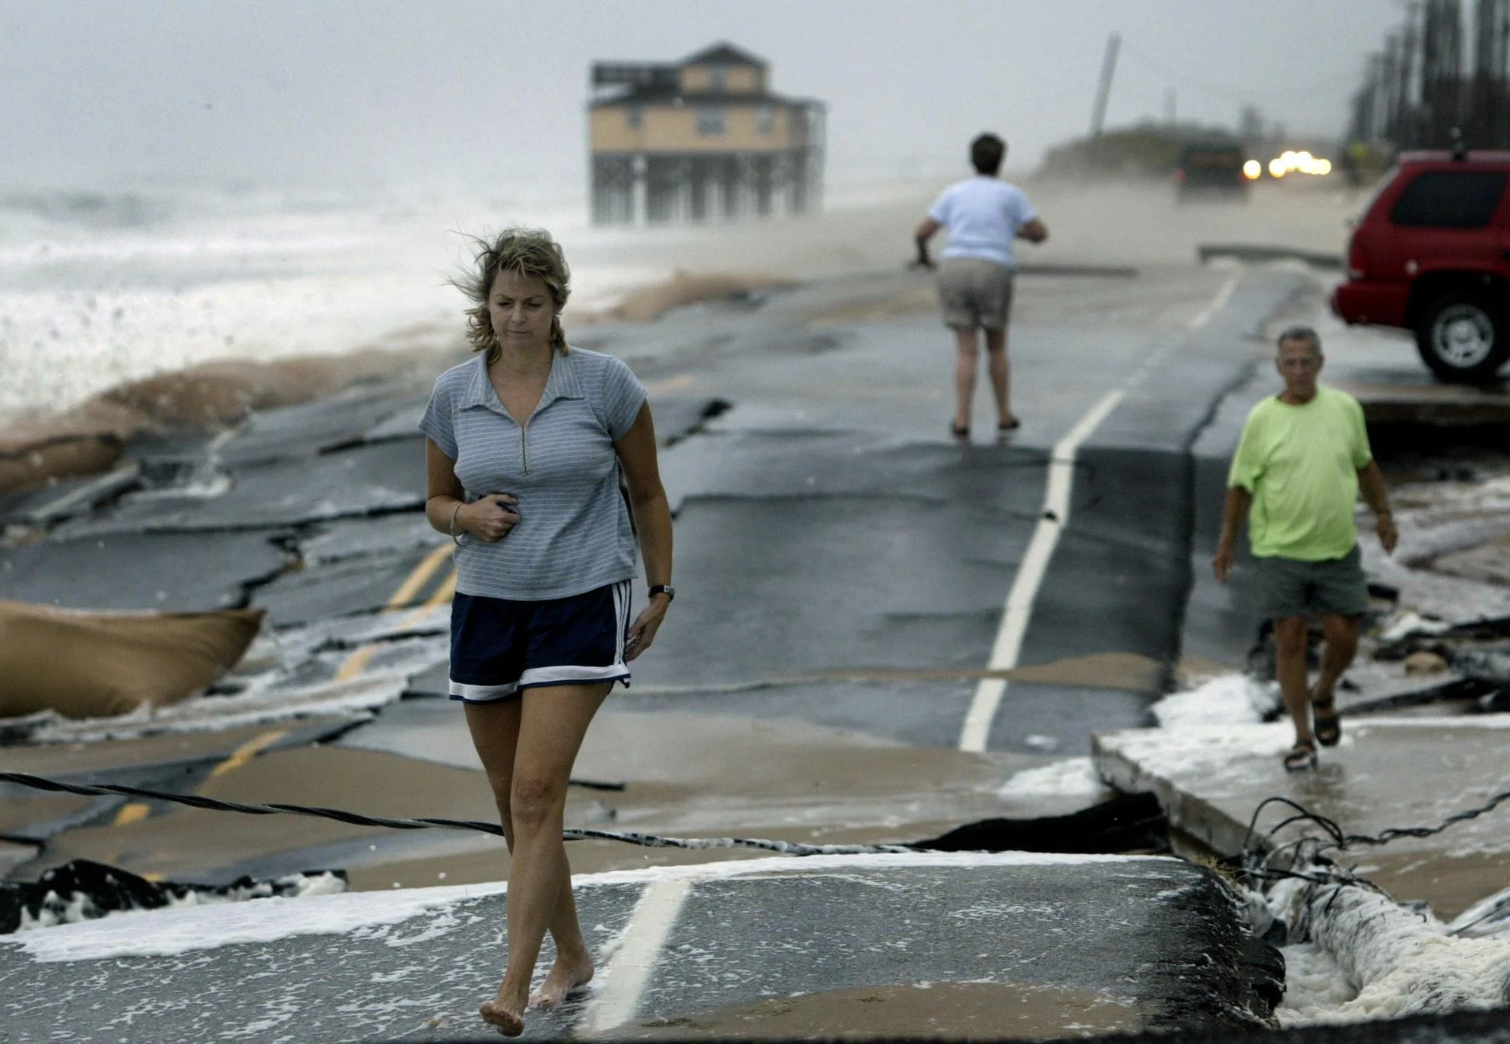
Climate Change

Slide 2
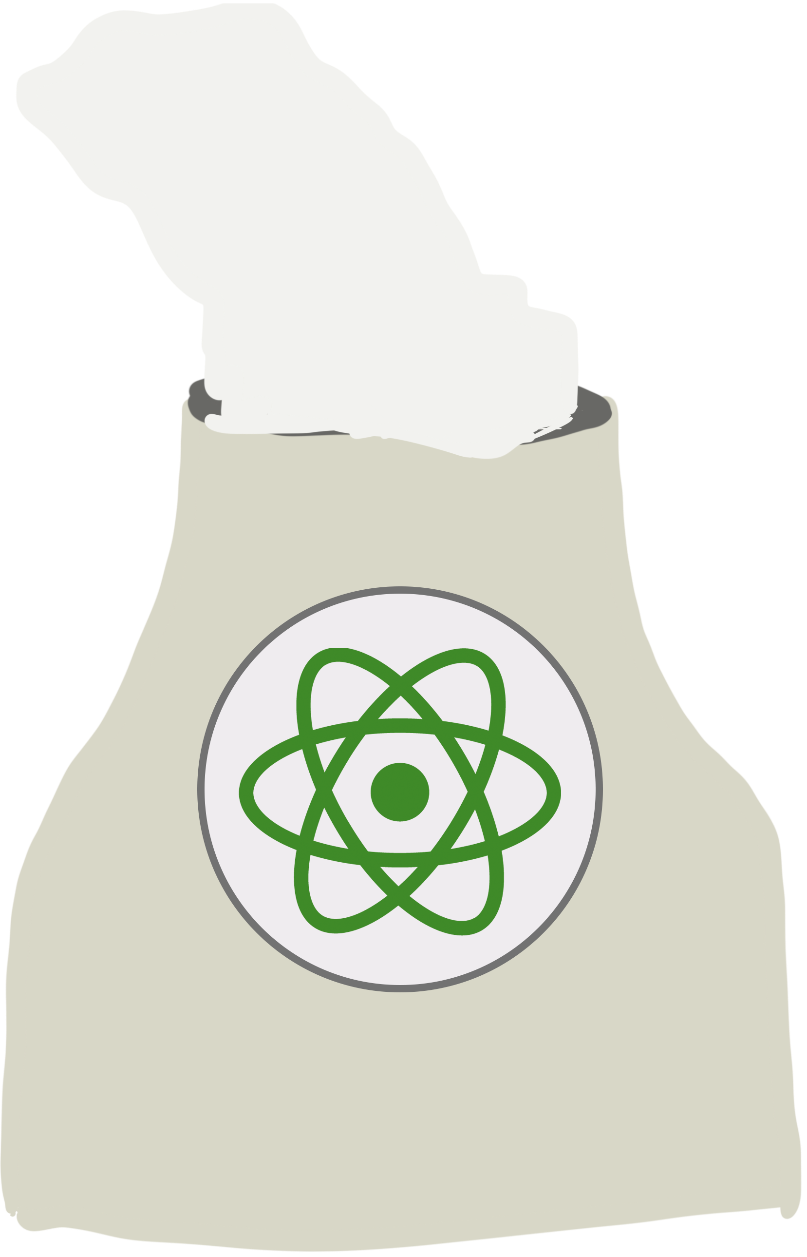
U.S. Energy Sources
Source: eia.gov/energyexplained/us-energy-facts
Data as of 2019
Notes:
The US could pay for any costs that regulation have on development, so any
US pay for regulation cost ∴ cheap & safe.

Slide 3
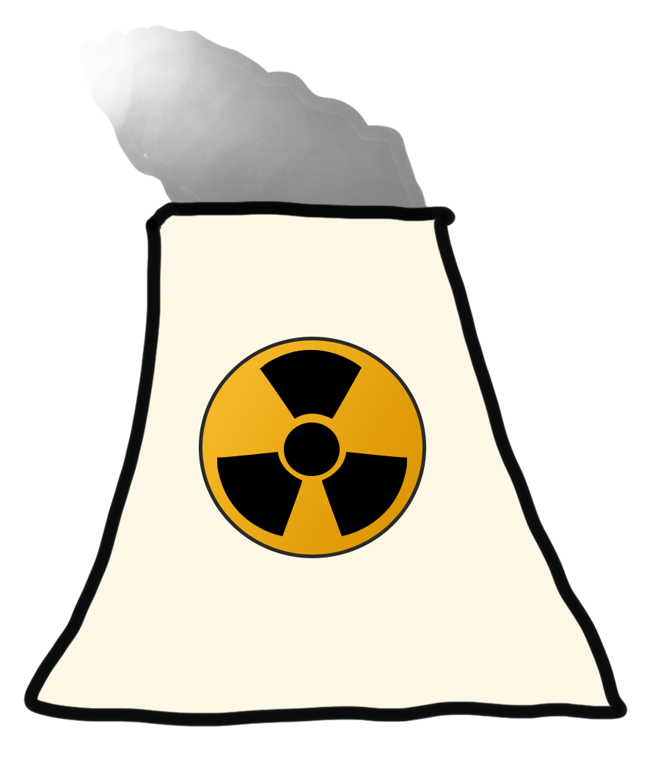
Nuclear Renaissance

Slide 4
Benefits
Safe & clean
Most consistent
Long-term savings
High-paying jobs
Grow economy & middle class
more…

Slide 5
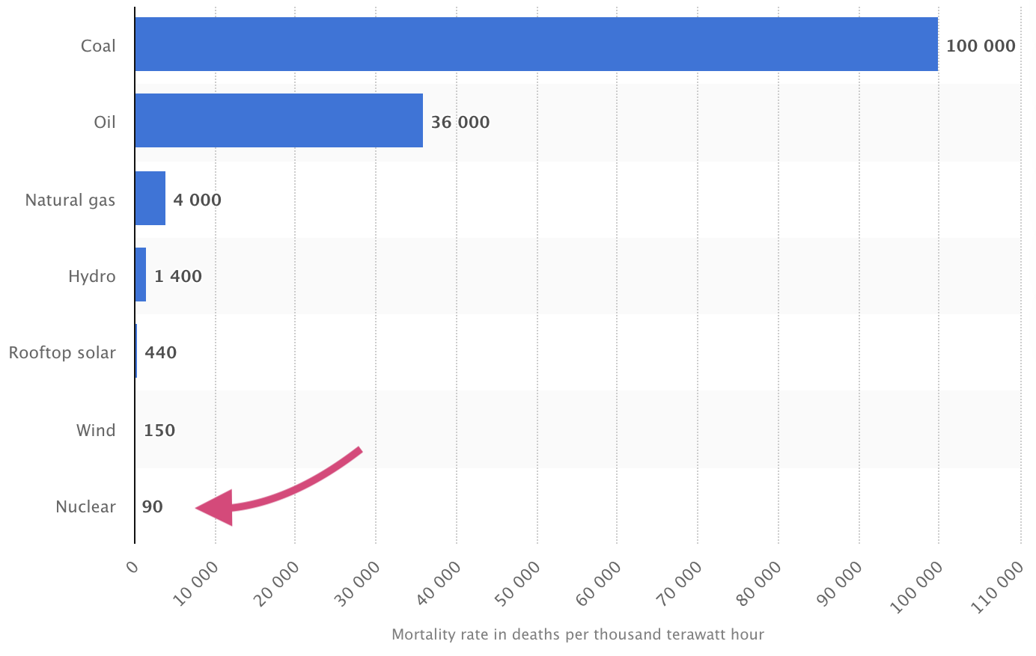
Bad Reputation from Myths
Fear of disaster → safest
Fear of leaking radiation → not true
Association with nuclear weapons
Source: Pew Research Center

Slide 6
Addressing Legitimate Concerns
Mining damages land
Waste
Uranium will run out in 80 years

Slide 7
Examples
Country % electricity from nuclear
France 70%
China 5% (rapidly expanding)
Slovakia 82%

Slide 8
What’s Holding Back the U.S.?
Bad social reputation
Regulations
Natural gas is cheaper

Slide 9
Economics
Natural Gas - short-term
Nuclear - long-term

Slide 10
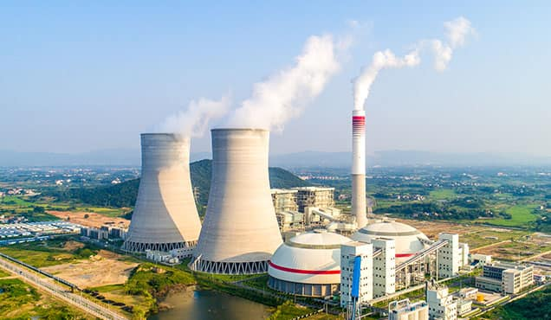
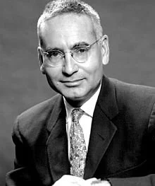
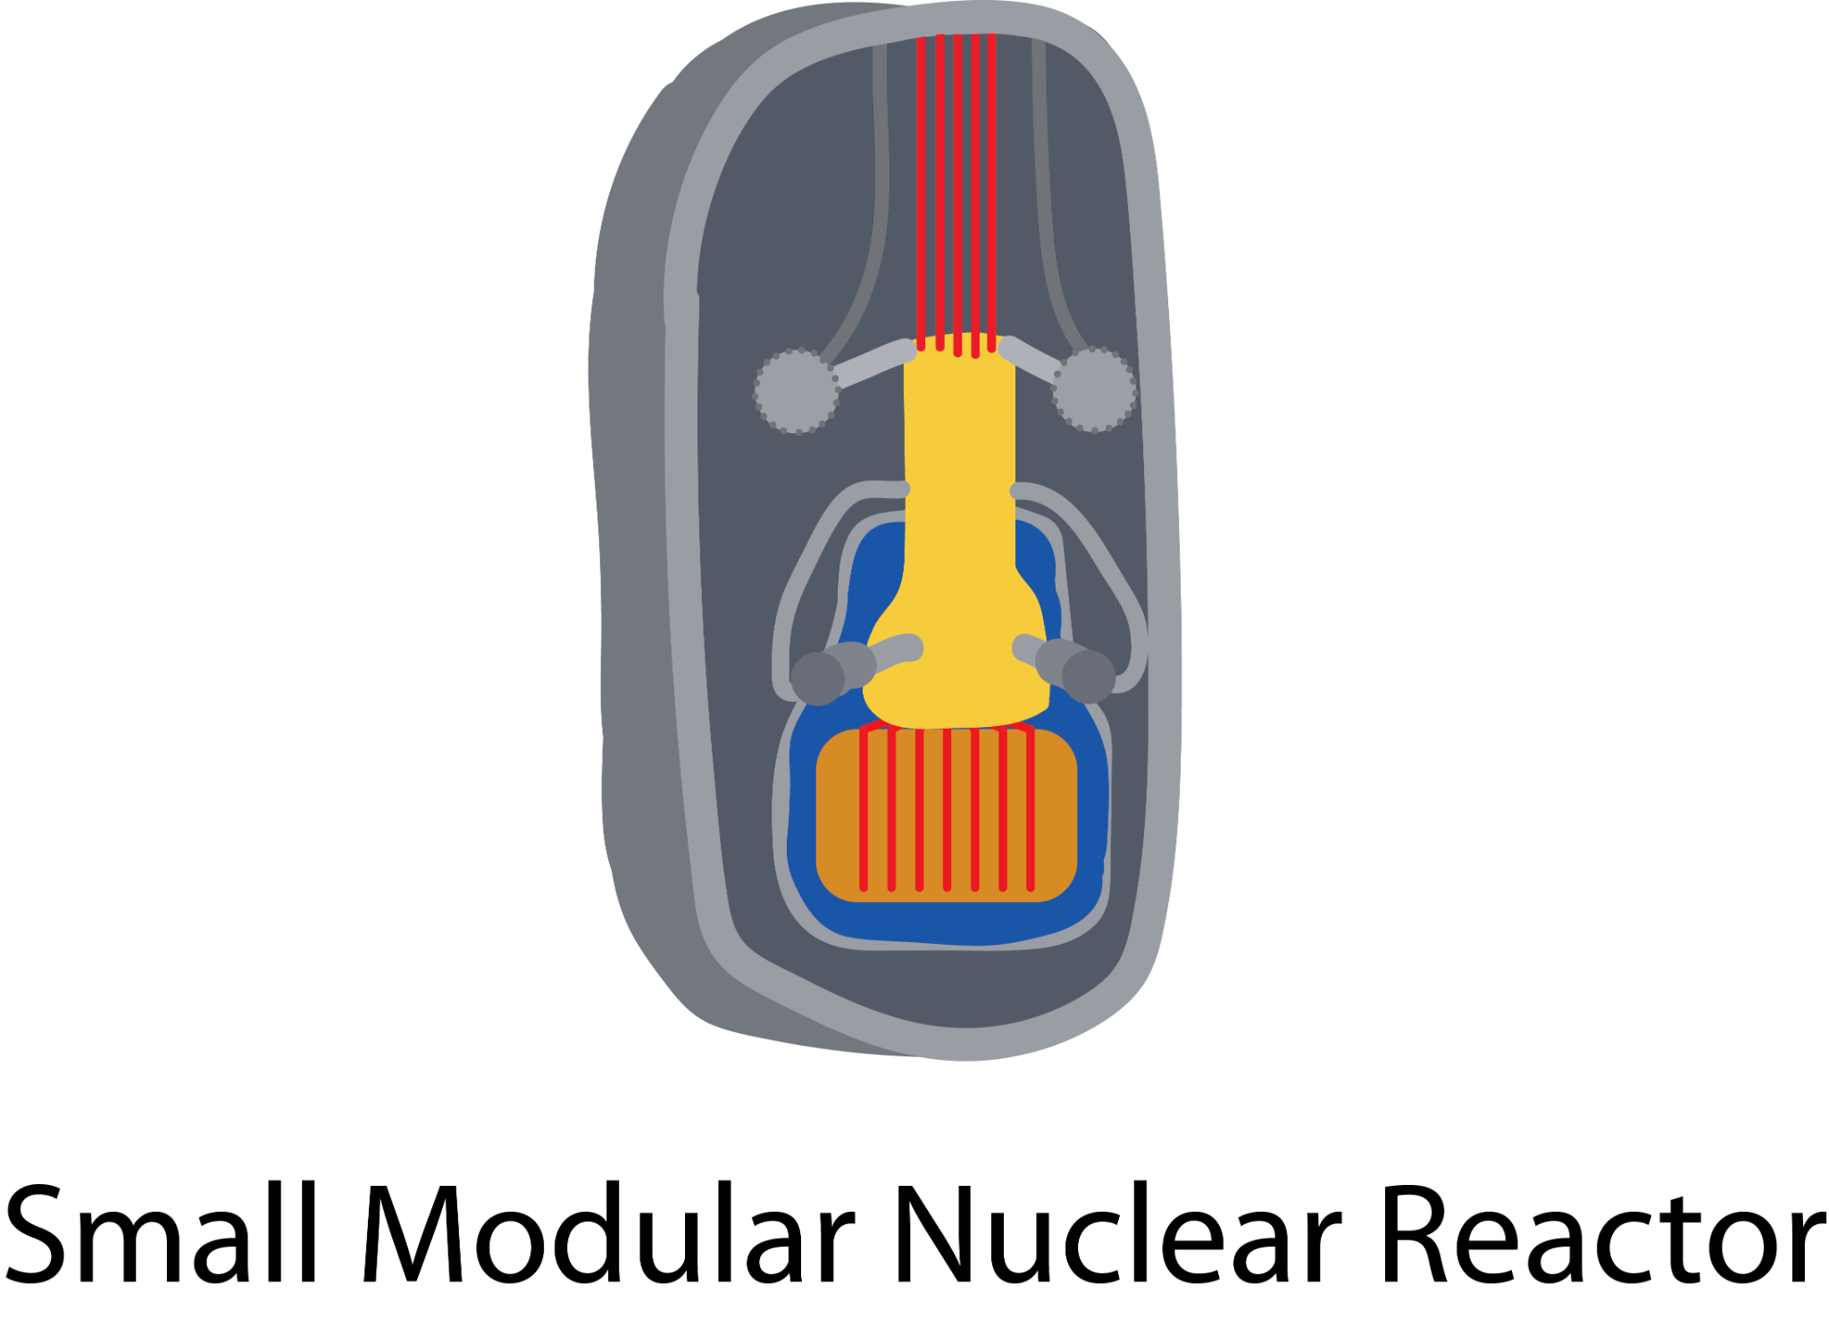
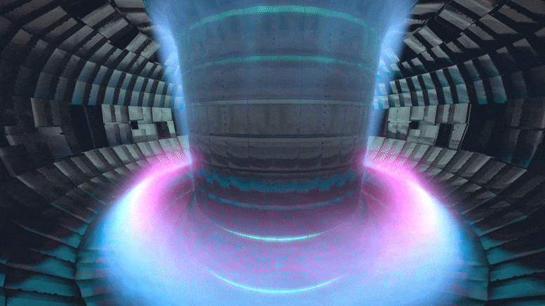
Nuclear Energy Types
Alvin Weinberg,
Thorium advocate & researcher
Traditional Uranium
Fusion
Notes:
[Research new energy sources]
[Hold thorium ball] This ball that fits in my hand is the amount of thorium needed to power all your energy needs for your entire lifetime.
Batteries will help renewables be less volatile

Slide 11
Sources
joelgrayson.com/perspective/nuclear-energy
eia.gov/tools/faqs/faq.php
nytimes.com/interactive/2020/10/28/climate/how-electricity-generation-changed-in-your-state-election.html
pubs.acs.org/doi/abs/10.1021/es3051197?source=cen

